Slide 1

DATABASE MANAGEMENT SYSTEM WITH MINI PROJECT(21CSL55)
K S SCHOOL OF ENGINEERING AND MANAGEMENT
DEPARTMENT OF ARTIFICIAL INTELLIGENCE AND DATA SCIENCE
BLOOD BANK MANAGEMENT SYSTEM
Under the Guidance of: Mrs. K PADMAPRIYA
Presented By:
HARSHITHA N – 1KG21AD012
MANYASHREE U J – 1KG21AD028
PRAJWAL C L – 1KG21AD036
JYOTHISH K S – 1KG22AD401

Slide 2

OVERVIEW
“Blood bank management system” is designed to develop an online blood system applying the concepts of database security and encryption that is easily retrievable. The blood bank management is known as a pilot project that is designed for the blood bank to gather blood from various sources and distribute to the needy people who have requirement. The software is designed to handle the daily transactions of blood and search the details when required. It helps to register the details of donors, blood collection details as well as blood issued reports.
Objective:
Develop a web-based blood bank management system that allows administrators to track blood donations, manage blood stocks, record blood receptions, and maintain donor/receiver information.

Slide 3
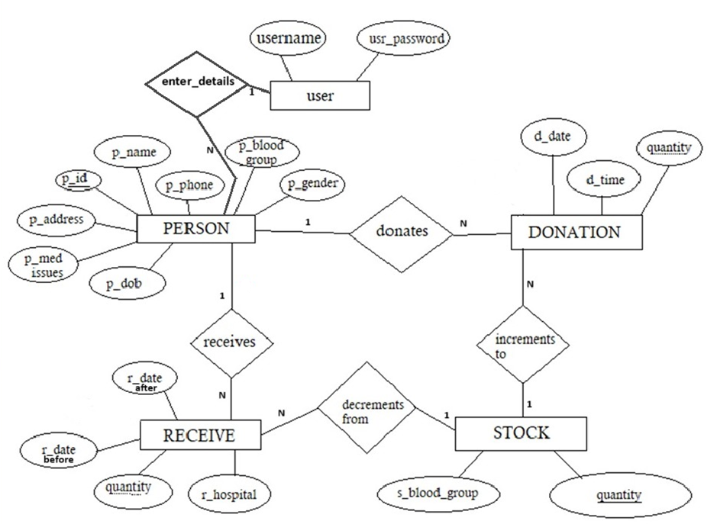
ER DIAGRAM

Slide 4
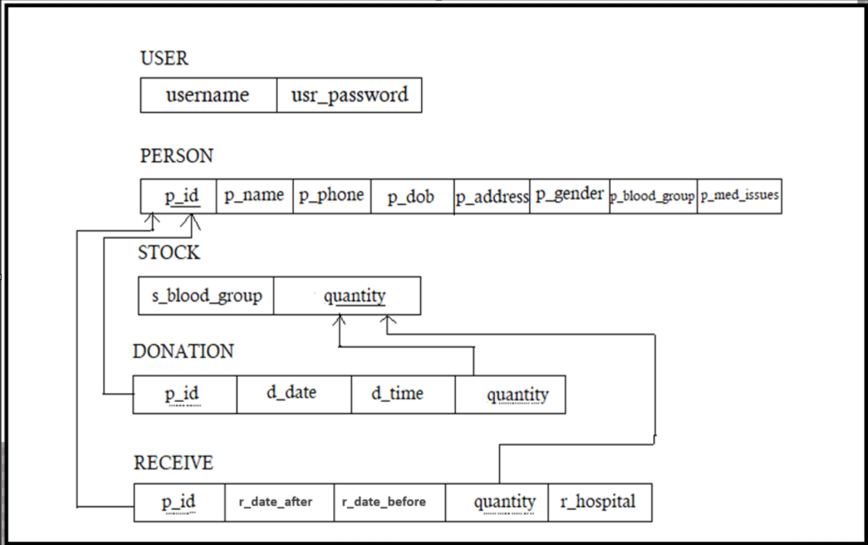
SCHEMA DIAGRAM

Slide 5

SQL QUERIES
Update a Person’s Phone Number.
UPDATE person SET p_phone = ‘9876543210’
WHERE p_name = ‘John Doe’;
Delete a Donation.
DELETE FROM donation WHERE p_id = 1 AND
d_date = ‘2023-08-23’ And d_time = ‘09:03:00’;
Find the Donor who donated the Highest quantity.
SELECT p_id, MAX(d_quantity) AS
max_donation_quantity FROM donation;
To Calculation Total Blood Quantity Received.
SELECT SUM(r_quantity)
FROM receive;

Slide 6

5. Find Donors by Gender.
SELECT p_gender, COUNT(*)FROM person
GROUP BY p_gender;
6. Find Donors who haven’t Donated yet.
SELECT*FROM person
WHERE p_id NOT IN(SELECT p_id FROM donation)
Find donors who have donated more than once in a day.
SELECT p_id, d_date, COUNT(*) AS donation_count
FROM donation
GROUP BY p_id, d_date
HAVING COUNT(*)>1;

Slide 7
LIMITATIONS OF BLOOD BANK MANAGEMENT SYSTEM
Data accuracy: Inaccurate or outdated information may lead to mismanagement of blood inventory or errors in matching donors with recipients.
Limited Accessibility: If the system is not web-based or mobile-friendly, it may only be accessible from certain locations or devices, limiting its usability and efficiency.
Temperature Monitoring: Blood products must be stored at specific temperatures to maintain their integrity. Ensuring proper temperature monitoring and control throughout the storage and transportation process is essential to prevent spoilage and maintain product quality.

Slide 8
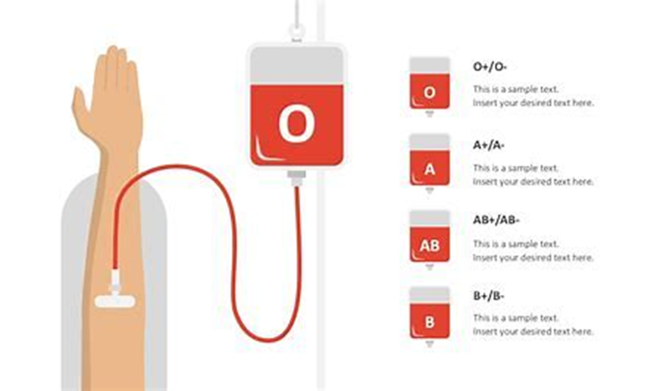
Cost constraints: Implementing and maintaining a blood bank management system can be expensive, potentially limiting access to smaller blood banks or organizations with limited budgets.
Integration issues: Difficulty in integrating with other healthcare systems may result in disjointed workflows and inefficiencies.
Expiration Management: Blood products have limited shelf lives, and tracking their expiration dates accurately is crucial to prevent wastage. Managing the rotation of inventory to minimize expired units requires precise tracking and forecasting capabilities.

Slide 9

CONCLUSION
The main purpose of our blood management system is to provide blood bank with easier way to store and retrieve data and keep record of the availability of blood in blood bank.
After inserting the data to database, staff need not register of the same person again. They can simply search for recorded data and retrieve them for future blood donation or receiving purpose of that person.

Slide 10


